Slide 1
Heart Disease Predictor
Shamus Sim​

Slide 2
Contents
Dataset Description​
Exploratory Data Analysis
Preprocessing
​Benchmarking
Classification Models
Model Comparison
Improvements
ML Explainability

Slide 3
Dataset Description
Heart Disease Prevalence and Significance
Heart disease, including conditions like coronary artery disease and heart attacks, is a major global health concern. It's a leading cause of death, affecting millions of individuals worldwide.
Doctor’s Diagnosis of Heart Disease
Doctors use a multifaceted approach to diagnose heart disease. This includes patient history, physical examinations, electrocardiograms (ECGs), echocardiograms, stress tests, and blood tests to assess risk factors and symptoms. They often employ invasive procedures like cardiac catheterization to visualize blood flow and arterial blockages. This comprehensive assessment helps doctors make informed decisions regarding treatment and lifestyle modifications.

Slide 4
Dataset Description
AI's Value in Diagnosing
AI plays a valuable role in heart disease diagnosis by analyzing large patient datasets, identifying patterns, and providing data-driven insights. It aids in early detection, offers decision support to healthcare providers, processes data rapidly, and can predict patient risk. AI also enables remote monitoring through wearable devices, enhancing preventive care.
Flaws in AI Methods
AI has limitations, including data bias from historical data, the risk of overreliance on technology, challenges with rare or complex cases, potential misinterpretation of recommendations, lack of transparency in some models, and ethical concerns surrounding privacy and data security.

Slide 5
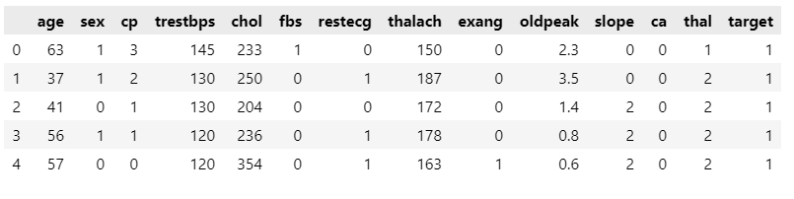
Exploratory Data Analysis: Features
target: Heart disease (0 = no, 1= yes)
age: The person’s age in years
sex: The person’s sex (1 = male, 0 = female)
cp: chest pain type: Value 0: asymptomatic Value 1: atypical angina Value 2: non-anginal pain Value 3: typical angina
trestbps: The person’s resting blood pressure (mm Hg on admission to the hospital).
chol: The person’s cholesterol measurement in mg/dl.
fbs: The person’s fasting blood sugar (> 120 mg/dl, 1 = true; 0 = false).

Slide 6
EDA: Features
restecg: resting electrocardiographic results Value 0: showing probable or definite left ventricular hypertrophy by Estes’ criteria Value 1: normal Value 2: having ST-T wave abnormality (T wave inversions and/or ST elevation or depression of > 0.05 mV).
thalach: The person’s maximum heart rate achieved.
exang: Exercise induced angina (1 = yes; 0 = no)
oldpeak: ST depression induced by exercise relative to rest (‘ST’ relates to positions on the ECG plot.
slope: the slope of the peak exercise ST segment
0: upsloping; 1: flat; 2: downsloping
ca: The number of major vessels (0–3)
thal: A blood disorder called thalassemia
Value 0: NULL (dropped from the dataset previously Value 1: fixed defect (no blood flow in some part of the heart) Value 2: normal blood flow Value 3: reversible defect (a blood flow is observed but it is not normal)

Slide 7
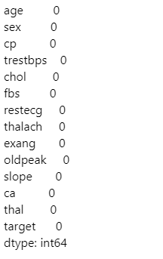

EDA
Check for Null Values
-Great no NULL values present ☺
2. Split features into categorical and continuous for different data analysis techniques
-If we have more than 10 unique values for a feature, we label it as continuous

Slide 8
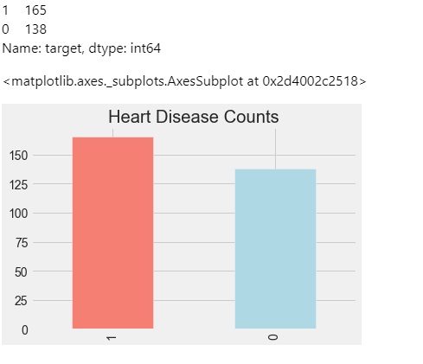
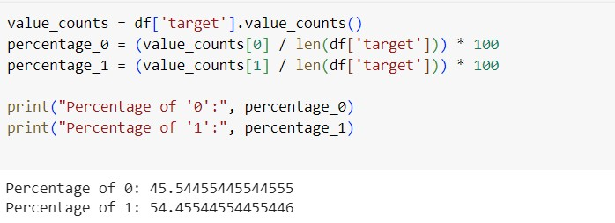
EDA
3. Check for class balance
165 people with heart disease and 138 healthy people.
Although we don’t have the exact some no of 0 and 1 examples. Anything less than a 60/40 split shouldn't affect ML's performance and generalizability.
We can consider the class as balanced.☺

Slide 9
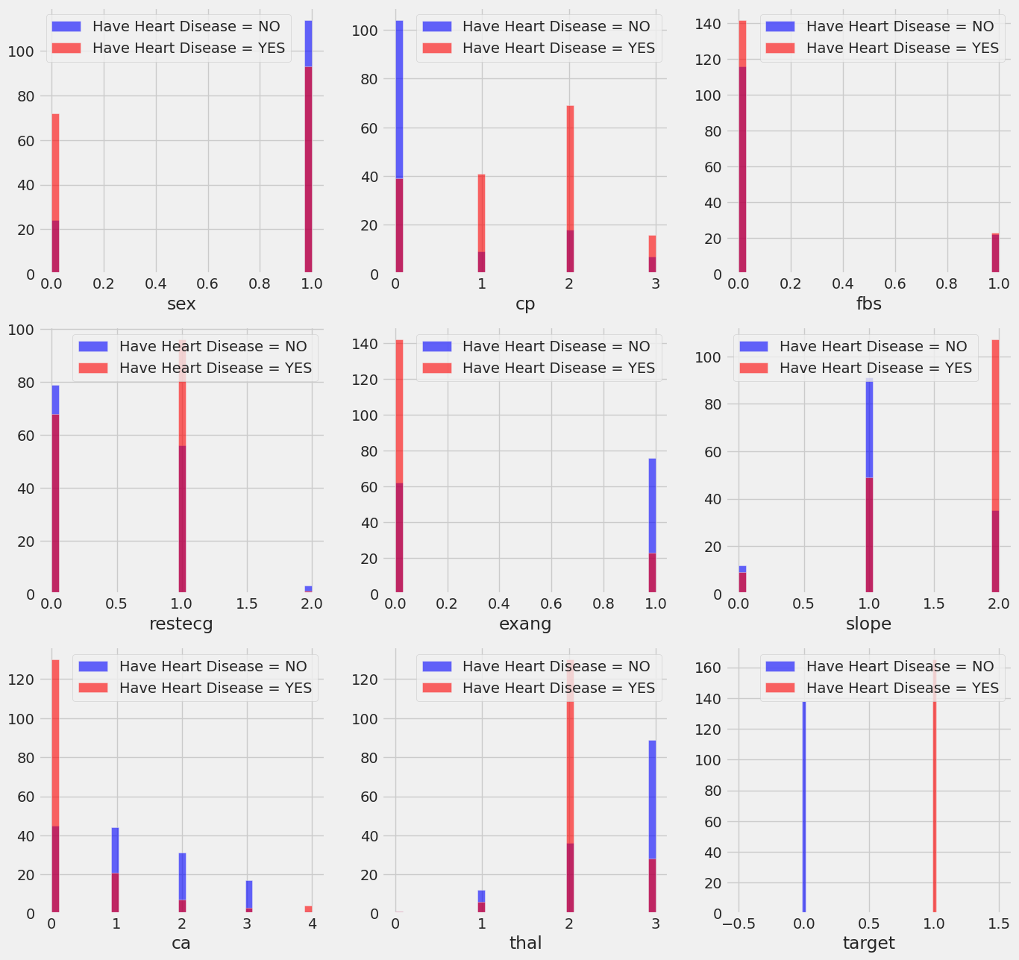
EDA
The darker shade of red shows us where the values overlap.
Data Visualisation:
Study of the relationship of categorical
features and heart disease

Slide 10
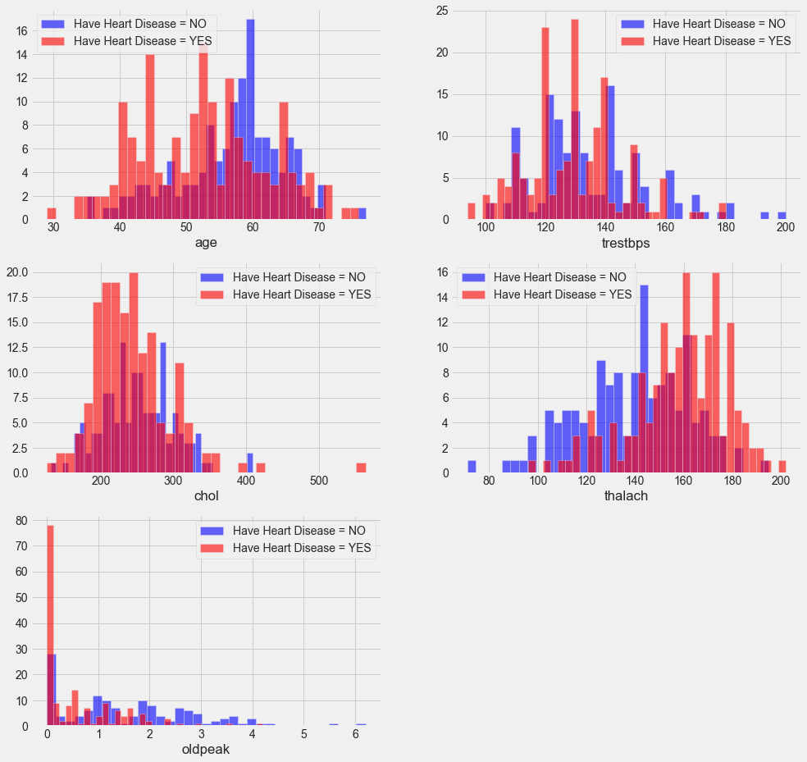
EDA
The darker shade of red shows us where the values overlap.
Data Visualisation:
Study of the relationship of continuous
features and heart disease

Slide 11
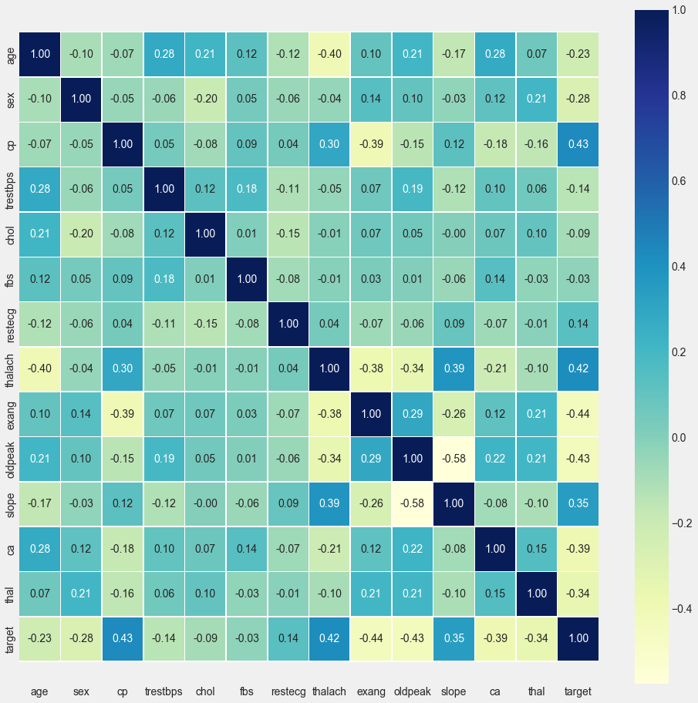
EDA
The darker shade of red shows us where the values overlap.
Spearman Correlation Test
-It's always important to recall the assumptions behind all correlation methods. Here we use Spearman as it a non-parametric test that don’t assume any relationship between features.
1.fbs and chol are the features least related to the
target variable.
2.All other features have at least some correlation (>|0.1|) with the target variable.

Slide 12
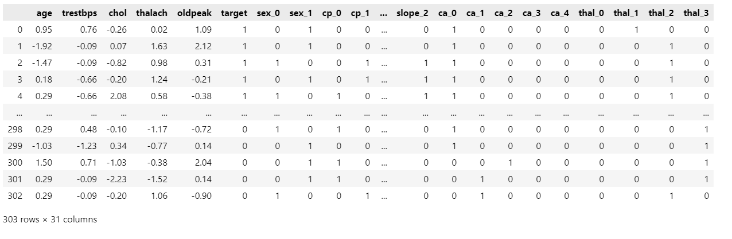
Machine Learning Preprocessing
Scale continuous features ['age', 'trestbps', 'chol', 'thalach', 'oldpeak’]
The standard score of a sample x is calculated as:
z = (x - u) / s

Slide 13
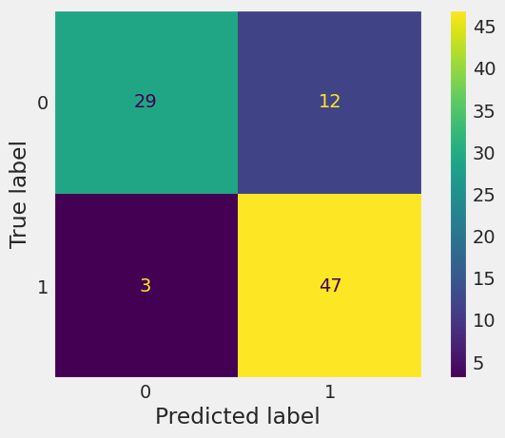
Benchmarking
Alpha: False Positive
There are multiple metrics for evaluation ML Binary Classifiers like accuracy, precision, recall, F1, ROC, support etc.
Often, there will be a tradeoff between false positive (Alpha) and false negative (Beta). In this case, it is important that the model has a low false negative (Beta). We want the model to not miss out on any patients that might have heart disease even if it means we are increasing our Alpha value.
However, note that a high Alpha rate may translate to more administrative cost/cost patient incurs. Ie. ML model notifies Doctor that a patient is in risk of Heart Disease when in fact he/she isn’t and therefore, patient send for more in-depth examinations.
Beta: False Negative

Slide 14
Benchmarking
Alpha: False Positive
Here, I take Alpha as my satisficing metric and Beta as my optimizing metric.
Satisficing Metric: As long as Alpha is below a certain value ie =10, I ‘accept’ the model.
Optimising Metric: The Beta metric that I want the lowest value possible.
Beta: False Negative

Slide 15
Machine Learning Classifiers
In the following analysis will compare between 4 different Classification models Logistic Regression, KNN, SVM and XGBoost in terms of predicting the Heart Disease. Where I am going to use the following techniques to help me in developing robust models:
Create 70/30 train test split
Cross-validation method
Grid Search
Metric measurements

Slide 16
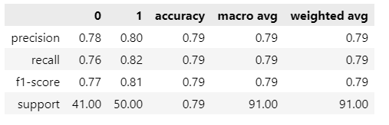
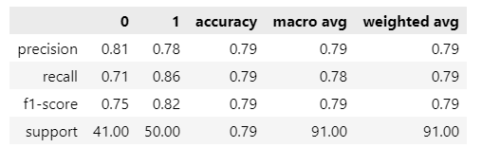
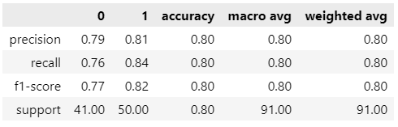
Logistic Regression
-Logistic Regression
-Logistic Regression with penalty=L1
-Logistic Regression with penalty=L2
This is our best model (marginally)

Slide 17
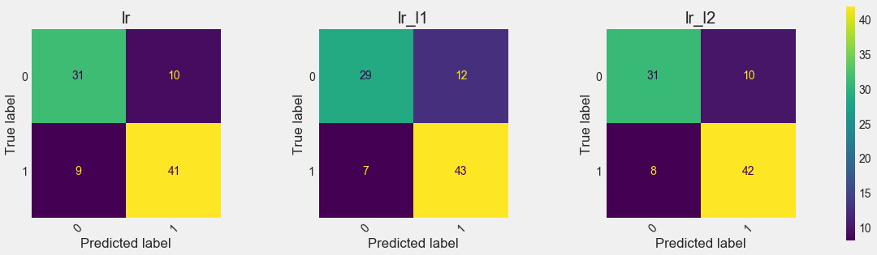
Logistic Regression
Alpha and Beta tradeoff analysis shows that LR with L1 has lowest Beta.

Slide 18
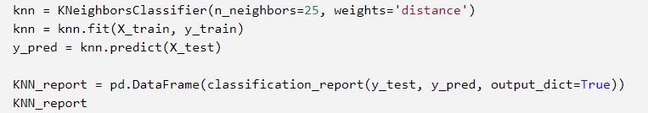
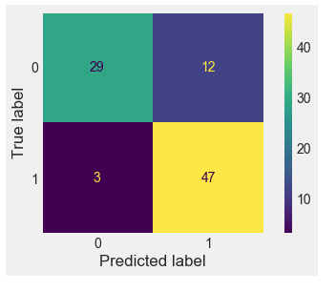
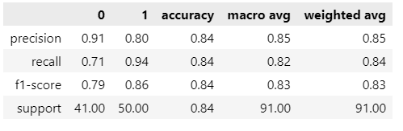
K-Nearest Neighbour
After exploring different parameters, we find that n_neighbours=25 gives the best performance.

Slide 19
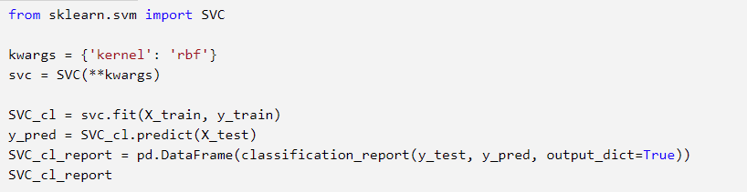
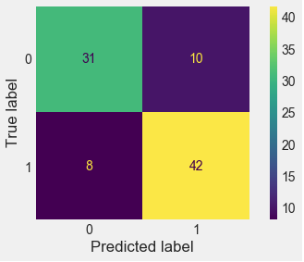
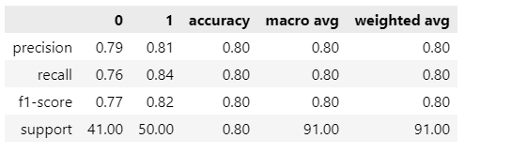
Support Vector Machine

Slide 20
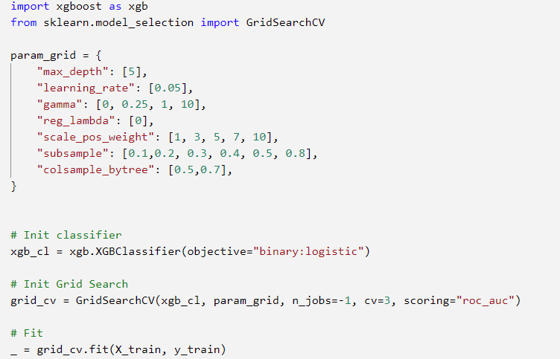
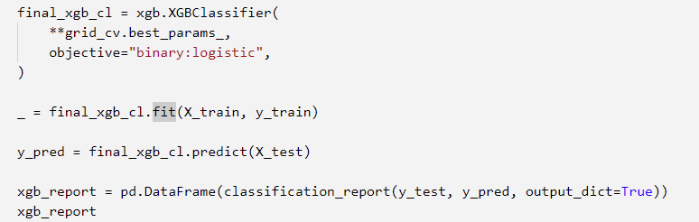
XGBoost

Slide 21
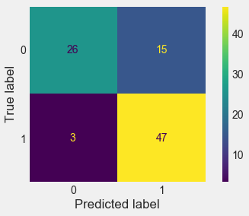
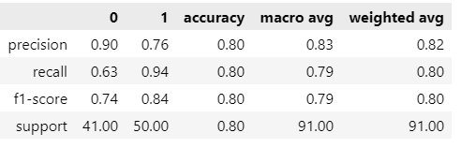
XGBoost

Slide 22
Model Comparison
The actual choice of model depends on the metric the ML Engineer chooses which should be informed by the Business Goal the team cares about.
Here, I choose the satistificing metric Alpha(false positive) to be at largest =10. 10 is my acceptable limit.
Optimising Metric: The Beta(false negative) metric that I want the lowest value possible.
In this case, only LR with L2 and SVM has alpha =10. LR with L2 has smaller beta value than SVM. Therefore, LR with L2 penalty is our best model.

Slide 23
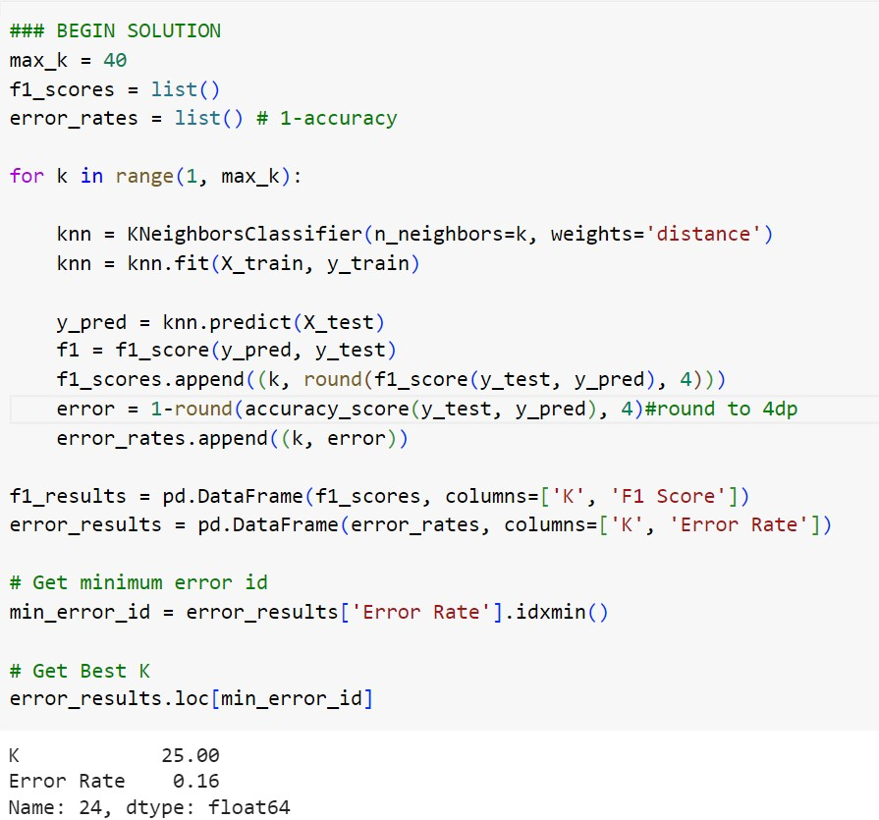
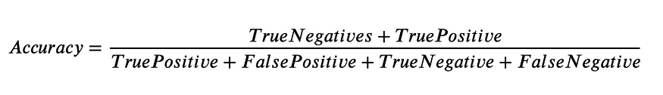
IMprovements
1.Finding n_neighbours by evaluating models on the metric we most care about
In the code here, I am finding the best value of n_neighbours by tracking the error rates of different models and finding the lowest one which is K=25.
My error was defined by 1 – accuracy.
I suggest defining error rate based on a metric you care the most about (ie false negative as previously discussed, ROC, AUC etc)

Slide 24
IMprovements
1. Is it better to use ROC curve?

Slide 25
Explainability
Logisitc Regression, KNN, SVM and XGBoost are are relatively simple and intuitive ML Algorithms. Nonetheless in building ML products for Healthcare, the explainability of the inner mechanisms of the predictive algorithm is often important for governmental approval and adoption by Healthcare Professionals.
Here I used some a model agnostic technique- Permutation Feature Importance to attempt to peer in to see what are the most important features that the ML models take into account when making a prediction.

Slide 26
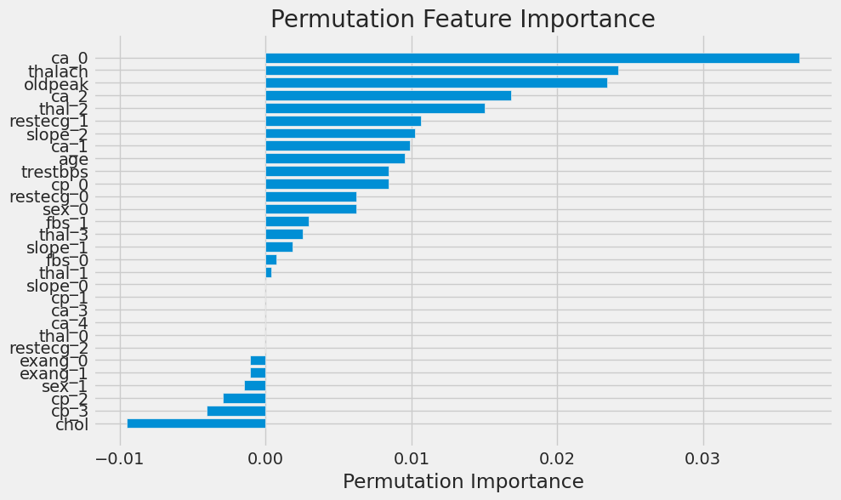
Explainability
Our best performing Logistic Regression is the LR model with L2 penalty.
This shows the feature importance graph. The higher the absolute value the more important the feature.
A Doctor for instance can look at the ‘key’ features the ML model considers and see if that lines up with their medical knowledge.

Slide 27
Explainability
Similarly, for KNN.

